Slide 1
NoSQL and Graph Databases: Principles

Slide 2
Agenda
Graph Databases: Mission, Data, Example
A Bit of Graph Theory
Graph Representations
Improving Data Locality (efficient storage)
Graph Partitioning and Traversal Algorithm
Types of Queries
Graph Databases
Neo4j
Data model
Traversal of the graph
Cypher query language

Slide 3
RDBMS recap
RDBMS are predominant database technologies
Since 1970
Data modeled as relations (tables)
object = tuple of attribute values
tables contain objects of the same type
tables interconnected via foreign keys
Use SQL query language

Slide 4
Advantages of Relational Databases
A (mostly) standard data model
Many well developed technologies
physical organization of the data
search indexes: B⁺-Trees, hash indexes
query optimization, search operator implementations
Reliable concurrency control (ACID)
transactions: atomicity, consistency, isolation, durability
Many reliable integration mechanisms
“shared database integration” of applications

Slide 5
NoSQL Databases
What is “NoSQL”?
term used in late 90s for a different type of technology: Carlo Strozzi: http://www.strozzi.it/cgi-bin/CSA/tw7/I/en_US/NoSQL/
“Not Only SQL”?
but many RDBMS are also “not just SQL”
“NoSQL is an accidental term with no precise definition”
first used at an informal meetup in 2009 in San Francisco (presentations from Voldemort, Cassandra, Dynomite, HBase, Hypertable, CouchDB, and MongoDB)
[Sadalage & Fowler: NoSQL Distilled, 2012]

Slide 6
NoSQL Databases (cont.)
NoSQL: Database technologies that are (mostly):
Not using the relational model (nor the SQL language)
Designed to run on large clusters (horizontally scalable)
No schema - fields can be freely added to any record
Open source
Based on the needs of 21st century web estates
[Sadalage & Fowler: NoSQL Distilled, 2012]
Other characteristics (often true):
easy replication support (fault-tolerance, query efficiency)
simple API
eventually consistent (not ACID)

Slide 7
Four Basic Types of NoSQL Databases
Key-value stores
Document databases
Column-family stores
Graph databases
In this course we will discuss only graph databases in details

Slide 8
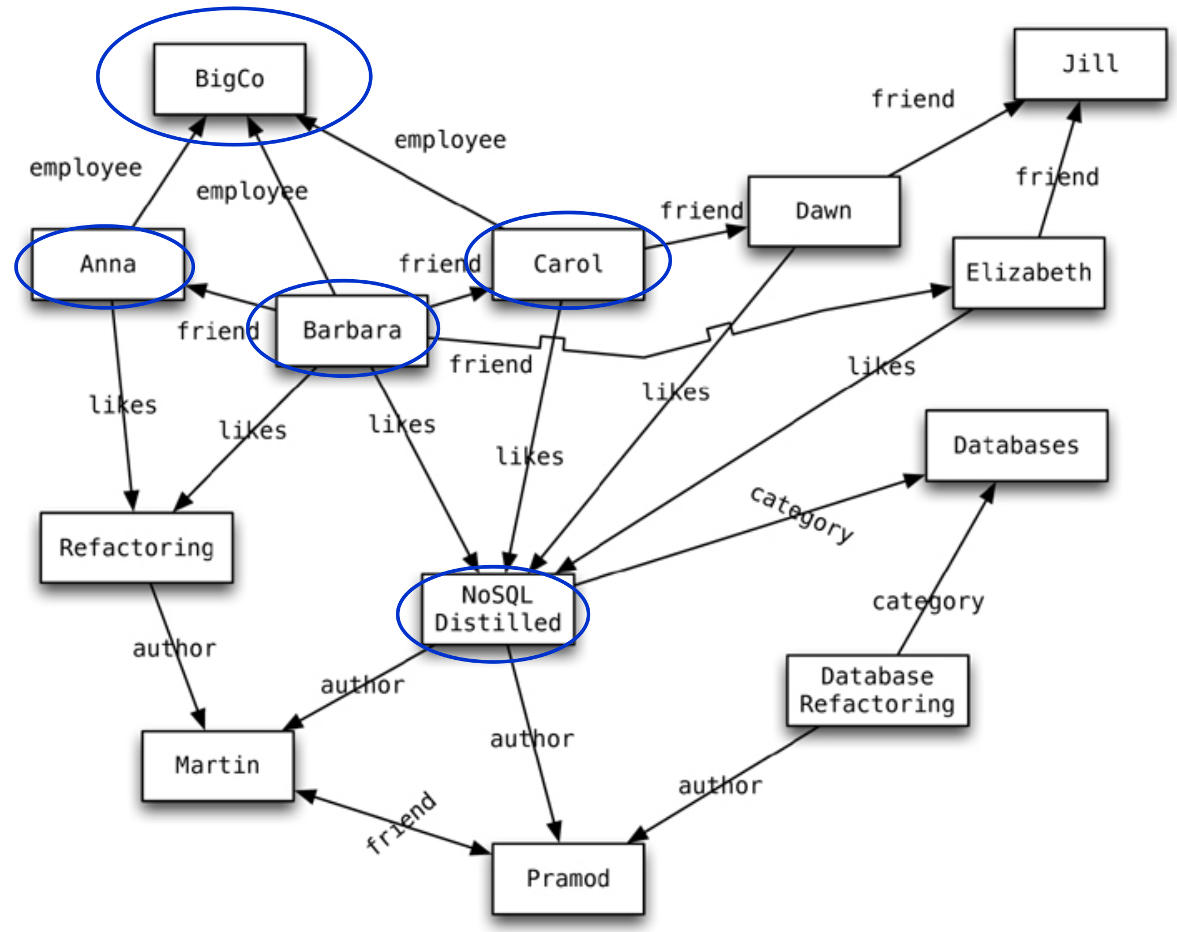
Graph Databases: Example
source: Sadalage & Fowler: NoSQL Distilled, 2012

Slide 9
Graph Databases: Mission
To store entities and relationships between them
Nodes are instances of objects
Nodes have properties, e.g., name
Edges connect nodes and have directional significance
Edges have types e.g., likes, friend, …
Nodes are organized by relationships
Allow to find interesting patterns
example: Get all nodes that are “employee” of “Big Company” and that “likes” “NoSQL Distilled”

Slide 10
Basic Characteristics
Different types of relationships between nodes
To represent relationships between domain entities
Or to model any kind of secondary relationships
Category, path, time-trees..
No limit to the number and kind of relationships
Relationships have: type, start node, end node, own properties
e.g., “since when” did they become friends

Slide 11
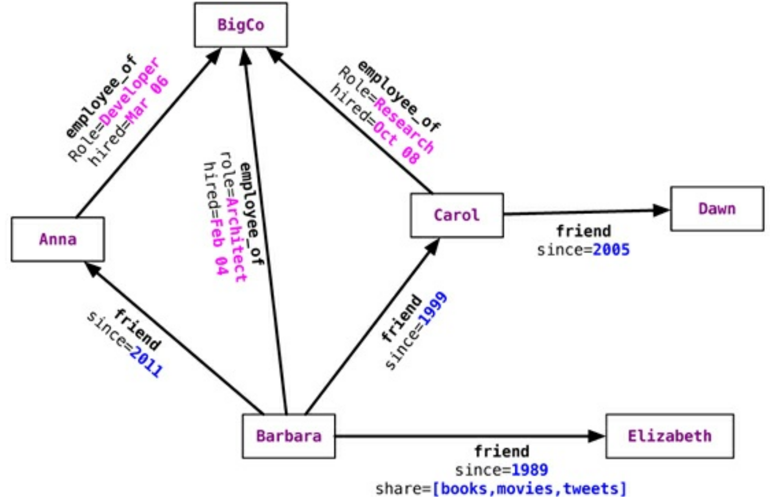
Relationship Properties: Example
source: Sadalage & Fowler: NoSQL Distilled, 2012

Slide 12
Implicit schema within application Example: Neo4j
Node martin = graphDb.createNode();
martin.setProperty("name", "Martin");
Node pramod = graphDb.createNode();
pramod.setProperty("name", "Pramod");
Relationship m2p = martin.createRelationshipTo(pramod, FRIEND);
Relationship p2m = pramod.createRelationshipTo(martin, FRIEND);
m2p.setProperty("quality", "a good one");
m2p.setProperty("quality", "a good one");
Undirected edge:
Relationship between the nodes in both directions
INCOMING and OUTGOING relationships from a node

Slide 13
A Bit of a Theory
Data: a set of entities and their relationships
=> we need to efficiently represent graphs
Basic operations:
finding the neighbours of a node,
checking if two nodes are connected by an edge,
updating the graph structure, …
=> we need efficient graph operations
graph G = (V, E) is commonly modelled as
set of nodes (vertices) V
set of edges E
n = |V|, m = |E|
Which data structure to use?

Slide 14
Data Structure: Adjacency Matrix
Two-dimensional array A of n ⨉ n Boolean values
Indexes of the array = node identifiers of the graph
Boolean value A_{ij} indicates whether nodes i, j are connected
Variants:
(Un)directed graphs
Weighted graphs…

Slide 15
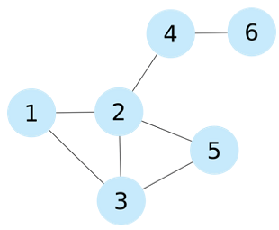
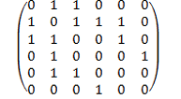
Adjacency Matrix: Example
Pros:
Adding/removing edges
Checking if 2 nodes are connected
Cons:
Quadratic space: O(n²)
We usually have sparse graphs
Adding nodes is expensive
Retrieval of all the neighbouring nodes takes linear time: O(n)

Slide 16
Data Structure: Adjacency List
A set of lists, each enumerating neighbours of one node
A vector of n pointers to adjacency lists
Undirected graph:
An edge connects nodes i and j
=> the adjacency list of i contains node j and vice versa
Often compressed
Exploiting regularities in graphs, difference from other nodes, …

Slide 17
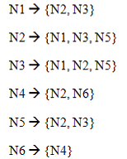
Adjacency List: Example
Pros:
Getting the neighbours of a node
Cheap addition of nodes
More compact representation of sparse graphs
Cons:
Checking if there is an edge between two nodes
Optimization: sorted lists => logarithmic scan, but also logarithmic insertion

Slide 18
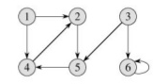
Excersice
Given the following directed graph:
Write the adjancecy matrix and list of it.

Slide 19
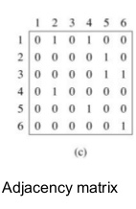
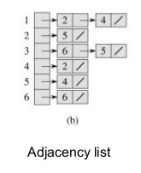
Solution

Slide 20
Bandwidth of a Matrix (optimization)
Graphs may be seen as matrices
Adjacency matrix
Locality problem -> minimum bandwidth problem
Bandwidth of a row in a matrix = the maximum distance between nonzero elements, where one is left of the diagonal and the other is right of the diagonal
Bandwidth of a matrix = maximum bandwidth of its rows
Low bandwidth matrices are more cache friendly
Non zero elements (edges) clustered about the diagonal

Slide 21
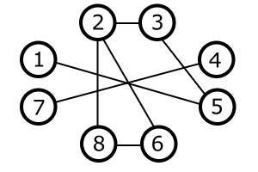
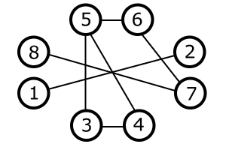
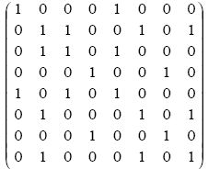
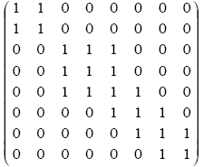
Matrix Bandwidth Minimization

Slide 22
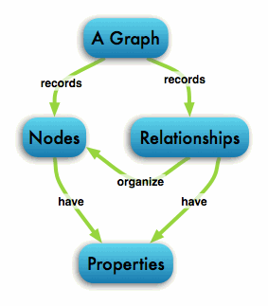
Graphs relationships
Single-relational graphs
Edges are homogeneous in meaning
e.g., all edges represent friendship

Slide 23
Graphs Relationships
Multi-relational (property) graphs
Edges are typed or labeled
e.g., friendship, business, communication
Vertices and edges maintain a set of key/value pairs
Representation of non-graphical data (properties)
e.g., name of a vertex, the weight of an edge

Slide 24
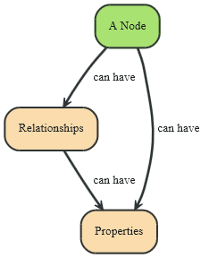
Neo4j: Data Model
Fundamental units: nodes + relationships
Both can contain properties
Key-value pairs
Value can be of primitive type or an array of primitive type
null is not a valid property value
nulls can be modelled by the absence of a key
http://db-engines.com/en/system/Neo4j

Slide 25
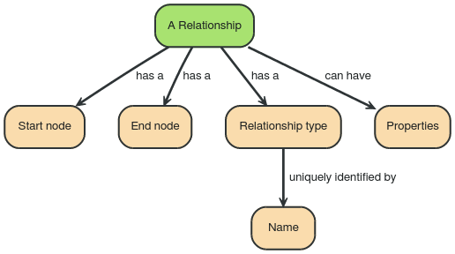

Data Model: Relationships
Directed relationships
Incoming and outgoing edge
Equally efficient traversal in both directions
Direction can be ignored when not needed by applications
Always have start and end node
Can be recursive

Slide 26
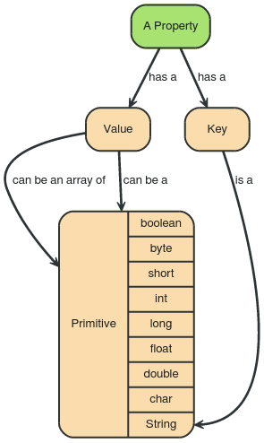
Data Model: Properties
Type | Description
boolean | true/false
byte | 8-bit integer
short | 16-bit integer
int | 32-bit integer
long | 64-bit integer
float | 32-bit IEEE 754 floating-point number
double | 64-bit IEEE 754 floating-point number
char | 16-bit unsigned integers representing Unicode characters
String | sequence of Unicode characters

Slide 27
Graphs (Neo4j) vs. RDBMS
RDBMS designed for a single type of relationship
“Who is my manager”
Adding another relationship usually means a lot of schema changes
In RDBMS we model the graph beforehand based on the traversal we want
If the traversal changes, the data will have to change
Graph DBs: the relationship is not calculated but persisted

Slide 28
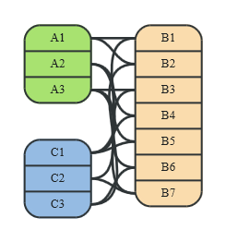
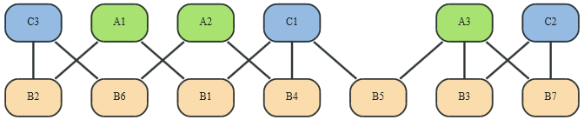
Graphs (Neo4j) vs. RDBMS (2)
RDBMS is optimized for aggregated data
Neo4j is optimized for highly connected data
It uses adjacency list as a data structure
Relational data
Graph data
source: http://neo4j.com/docs/stable/

Slide 29
Graph DBs: Suitable Use Cases
Connected Data
Social networks
Any link-rich domain is well suited for graph databases
Routing, Dispatch, and Location-Based Services
Node = location or address that has a delivery
Graph = nodes where a delivery has to be made
Relationships = distance
Recommendation Engines
“your friends also bought this product”
“when buying this item, these others are usually bought”

Slide 30
Graph DBs: When Not to Use
If we want to update all or a subset of entities
Changing a property on many nodes is not straightforward
e.g., analytics solution where all entities may need to be updated with a changed property
Some graph databases may be unable to handle lots of data
Distribution of a graph is difficult

Slide 31
Neo4j: Basic Info
Open source graph database
Initial release: 2007
Written in: Java
OS: cross-platform
Full transactions (ACID)
Partitioning: None
Replication: Master-slave
Eventual consistency

Slide 32
Neo4j in Server mode
Two ways to use Neo4j:
Self-standing server + connections
Embeded: Used directly within a Java application
Server mode:
download from http://neo4j.com/download/
extract neo4j-community-X.Y.Z.tar.gz
./bin/neo4j start
go to: http://localhost:7474/

Slide 33
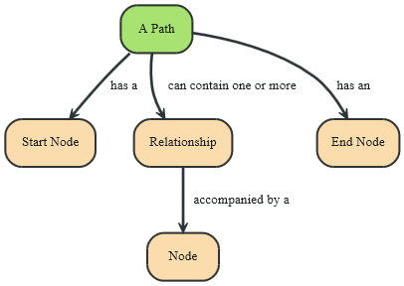
Data Model: Traversal + Path
Path = one or more nodes + connecting relationships
Typically retrieved as a query or traversal result
Traversing a graph = visiting its nodes, following relationships according to some rules
Typically, a subgraph is visited
Neo4j: Traversal framework + Java API , Cypher

Slide 34
Traversal Framework
To use traverse framework you need to know more about the algorithm you might use
A traversal is influenced by
Starting node(s) where the traversal will begin
Expanders – define what to traverse
i.e., relationship direction and type
Order – depth-first / breadth-first
Uniqueness – visit nodes (relationships, paths) only once
Evaluator – what to return and whether to stop or continue traversal beyond a current position

Slide 35
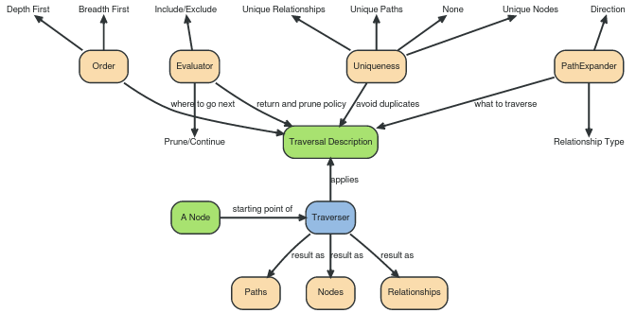
Traversal Framework

Slide 36
Cypher: Clauses
MATCH: The graph pattern to match
WHERE: Filtering criteria
RETURN: What to return
CREATE: Creates nodes and relationships.
DELETE: Remove nodes, relationships, properties
SET: Set values to properties
WITH: Divides a query into multiple parts
START: Starting points in the graph
by explicit index lookups or by node IDs (both deprecated)

Slide 37
Cypher: Creating Nodes (Examples)
CREATE n;
(create a node, assign to var n)
Created 1 node, returned 0 rows
CREATE (a: Person {name : 'David'})
RETURN a;
(create a node with label ‘Person’ and ‘name’ property ‘David’)
Created 1 node, set 1 property, returned 1 row

Slide 38
Cypher: Creating Relationships
START a=node(361), b=node(362)
CREATE a-[r:RELTYPE]->b
RETURN r ;
(create relations RELTYPE between nodes with IDs 1 and 2)
Created 1 relationship, returned 1 row
START a=node(1), b=node(2)
CREATE a-[r:RELTYPE {name : a.name + '->' + b.name }]->b
RETURN r
(set property ‘name’ of the relationship)
Created 1 node, set 1 property, returned 1 row

Slide 39
Cypher: Creating Paths
CREATE p = (andres: Person {name: 'Andres'})-[:WORKS_AT]->neo<- [:WORKS_AT]-(michael: Person {name:'Michael'})
RETURN p ;
(all parts of the pattern are created, if not existing)
p
[Node[4]{name:"Andres"},:WORKS_AT[2] {},Node[5]{},:WORKS_AT[3] {},Node[6]{name:"Michael"}]
1 row
Nodes created: 3
Relationships created: 2
Properties set: 2

Slide 40
Cypher: Changing Properties
MATCH (n: Person {name: 'Andres'})
SET n.surname = 'Taylor'
RETURN n
(find a node with name ‘Andres’ and set it surname ‘Taylor’)
n Node[0]{name:"Andres",surname:"Taylor"}
1 row
Properties set: 1

Slide 41
Cypher: Delete
MATCH (n: Person {name: 'Andres'})
DELETE n
(delete all Persons with name ‘Andres’)
Nodes deleted: 2
TransactionFailureException: Unable to commit transaction
MATCH (n: Person {name: 'Andres'}), (n-[r]-())
DELETE r,n
(first, we must delete all relationships of node with name ‘Andres’)
Nodes deleted: 1
Relationships deleted: 1

Slide 42
Cypher: Queries
MATCH (p: Person)
WHERE p.age > 18 AND p.age < 30
RETURN p.name
(return names of all adult people under 30)
MATCH (user: Person {name: 'Andres'})-[:friend]->(follower)
RETURN user.name, follower.name
(find all ‘friends’ of 'Andres')

Slide 43
Cypher: Queries (2)
MATCH (andres: Person {name: 'Andres'})-[*1..3]-(node)
RETURN andres, node ;
(find all ‘nodes’ within three hops from ‘Andres’)
MATCH p=shortestPath(
(andres:Person {name: 'Andres'})-[*]-(david {name:'David'})
)
RETURN p ;
(find the shortest connection between ‘Andres’ and ‘David’)

Slide 44
Guidelines on Data model Transformation (Relational -> graph )
Each entity table is represented by a label on nodes
Each row in a entity table is a node
Columns on those tables become node properties.
Remove technical primary keys, keep business primary keys
Add unique constraints for business primary keys, add indexes for frequent lookup attributes
Replace foreign keys with relationships to the other table, remove them afterwards
Remove data with default values, no need to store those
Data in tables that is denormalized and duplicated might have to be pulled out into separate nodes to get a cleaner model.
Indexed column names, might indicate an array property (like email1, email2, email3)
Join tables are transformed into relationships, columns on those tables become relationship properties

Slide 45
End
Questions

Slide 46
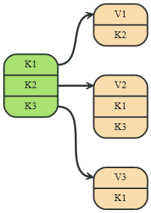
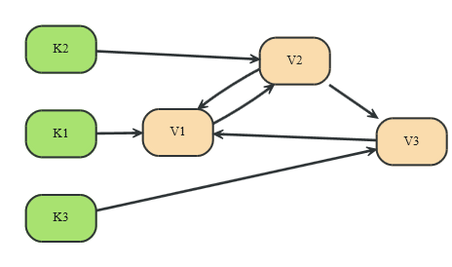
Graphs (Neo4j) vs. Key-value Stores
Key-value model is for lookups of simple values or lists
With Neo4j, one can elaborate simple data structures into more complex, interconnected data
Column-family stores can be considered a step in evolution of key-value stores
The value contains a list of columns
source: http://neo4j.com/docs/stable/

Slide 47
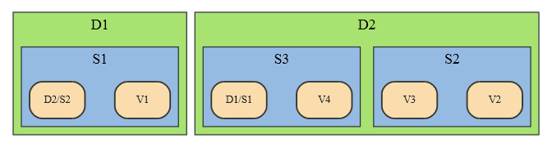
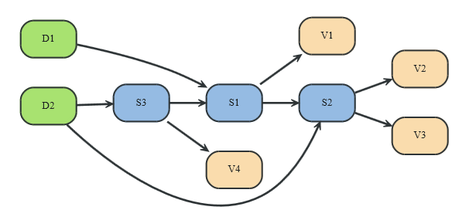
Graphs (Neo4j) vs. Document Stores
Document stores are for data that can be represented as a tree
References to other documents are more expressive
Graph databases are for free graph data
source: http://neo4j.com/docs/stable/

